Slide 1
Fundamentals of electric drive
Alexander Beshta
Electrotechnic faculty
Electric drive department
Presentation #1
Alexander Beshta
141
http://do.nmu.org.ua/course/index.php?categoryid=11

Slide 2
Basic concepts and determinations
Electric drive and its basic elements
Classification of electric drives
Basic directions of electric drive development

Slide 3
Basic concepts and determinations
Electric drive and its basic elements

Slide 4
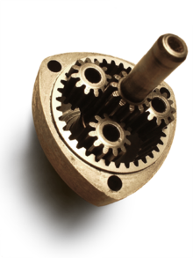
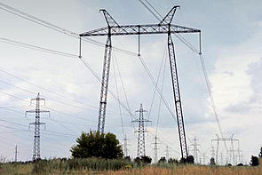
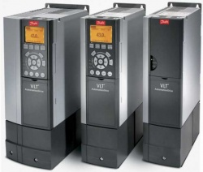
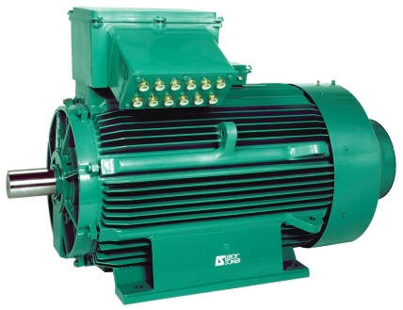
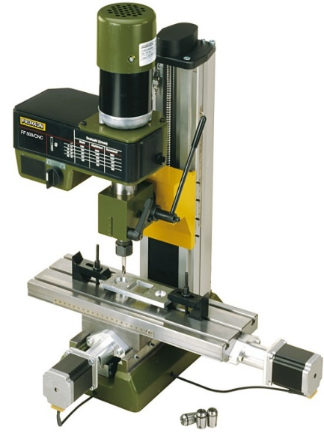
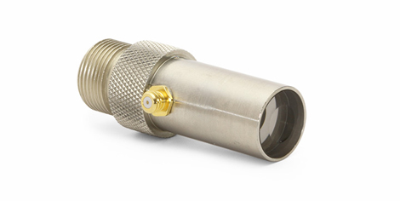
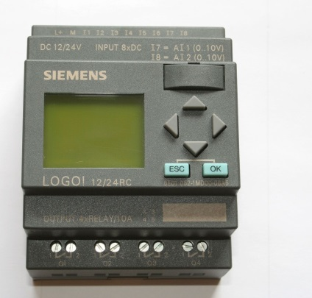
Electric drive and its basic elements
Three-phase transmission line
Convertor
Motor
Gear box
Machine tool
Transducer
Transducer
Transducer
Reference signals
Feedback
signals
Feedback
signals
Transducer
Controller
Reference signals
Feedback signals

Slide 5
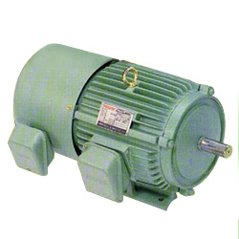
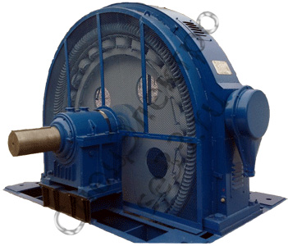
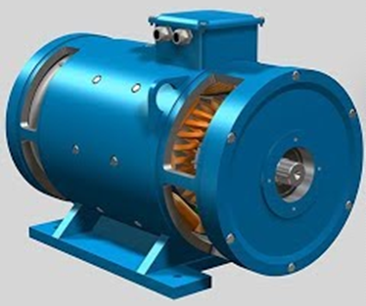
Types of electric motors
Function: transformation of electric energy into mechanical
ac motor
synchronous motor
dc motor

Slide 6
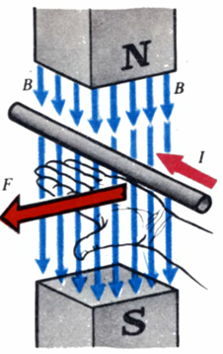
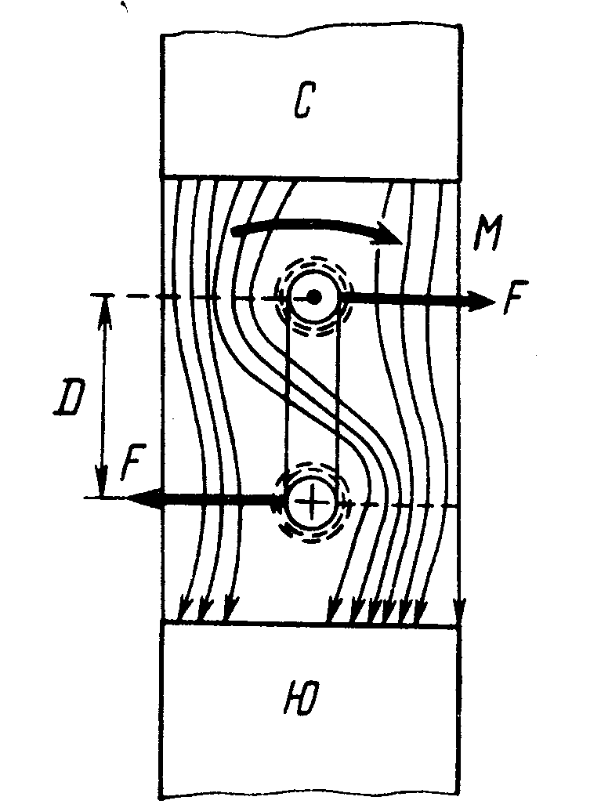
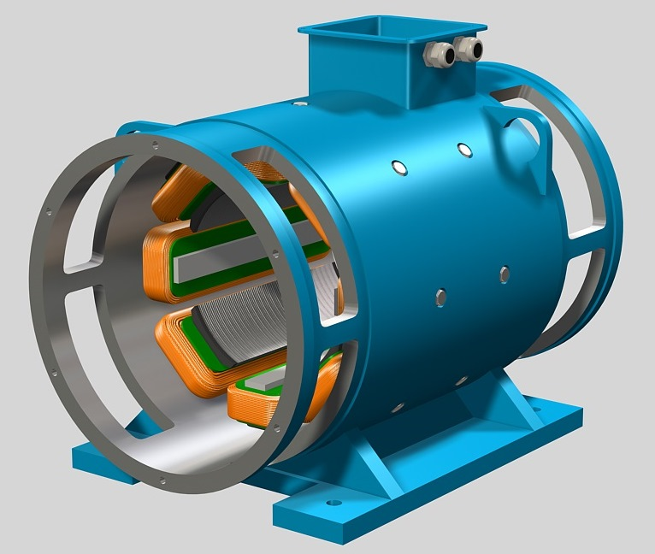
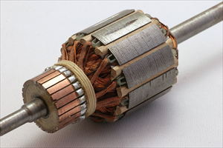
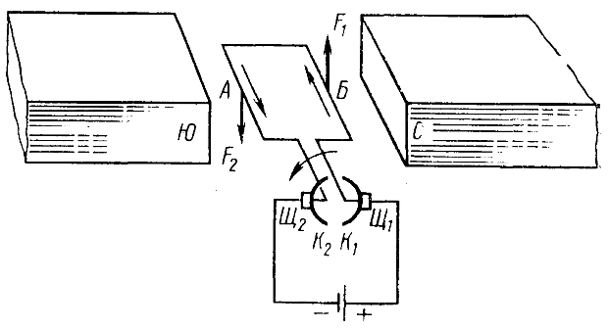
DC motor
N
T
Stator
Armature
S
F₂
$$F=BIL$$
T$=FD$
S
N
$B$ - induction
F₁
$F$ - force
$I$ - current
T - torque
Br₂
Br₁
$L$ – length of
the conductor
$D$ - diameter
C₂
C₁

Slide 7
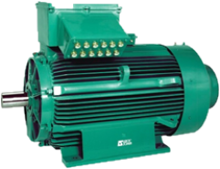
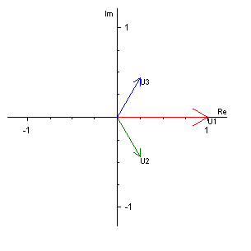
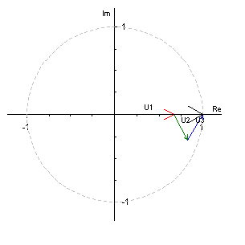
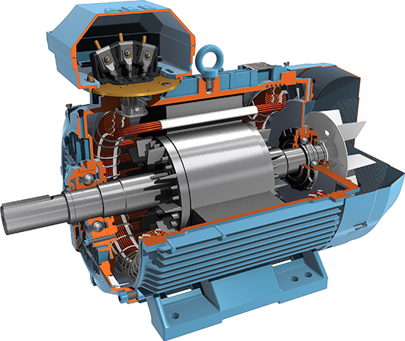
AC motor
A₁
A₁
B₂
C₂
B₂
C₂
Rotor
C₁
B₁
C₁
B₁
A₁
A₁
Stator
E$=−\frac{dΦ}{dt}$=k⋅ω_{r}⋅Φ

Slide 8
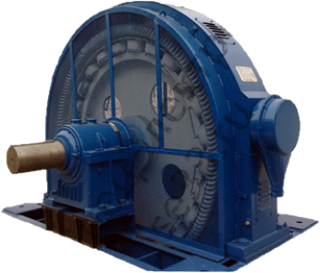
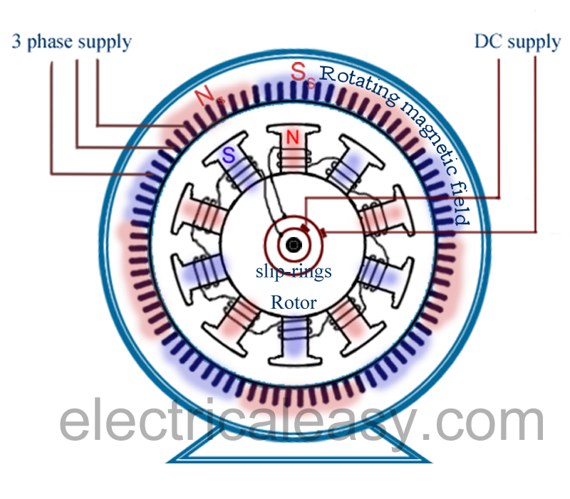
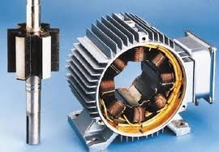
Synchronous motor
Synchronous motor with exiting winding
Synchronous motor with permanent magnets

Slide 9
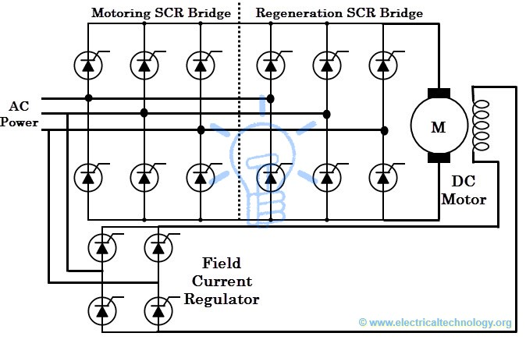
Converters
Function: conversion of electrical energy of one type into electrical energy of another type
Rectifier
Inverter

Slide 10
Transducers
Function: conversion of signals of various nature into standard electrical signals

Slide 11
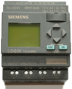
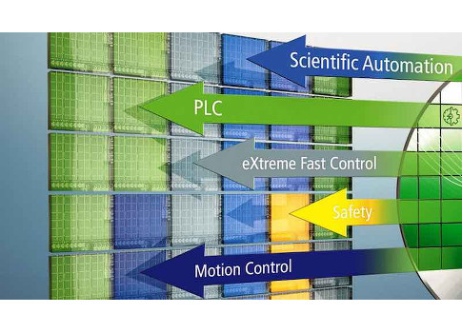
Controllers
Function: equipping machine-tools with control and automation functions
industrial PC (IPC),
programmable logic controller (PLC),
programmable automation controller (PAC)

Slide 12
Basic concepts and determinations
Classification of electric drives

Slide 13
Classification of electric drives
By the sort of current of drive engine:
direct current (DC)
alternating current (AC)

Slide 14
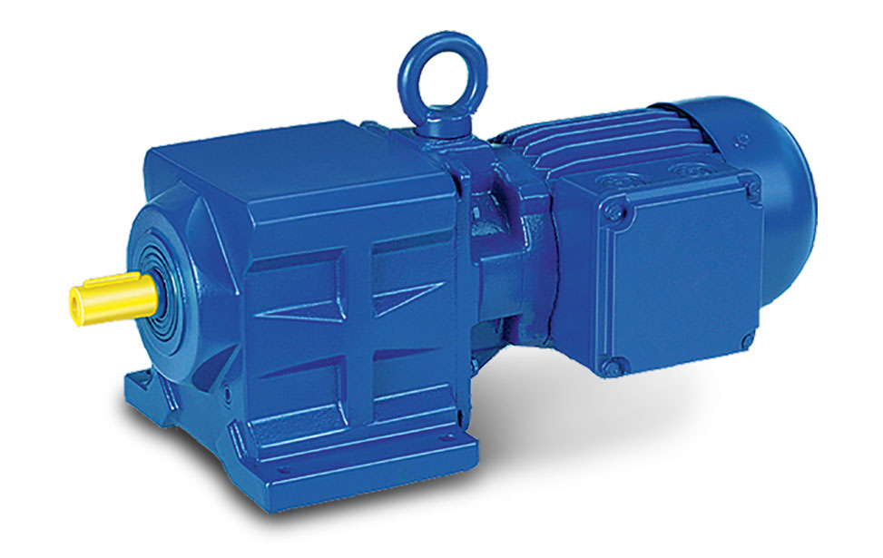
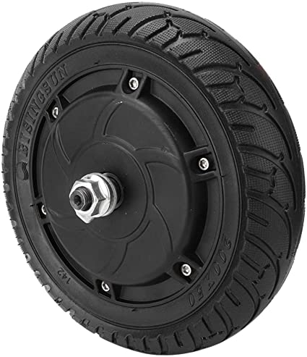
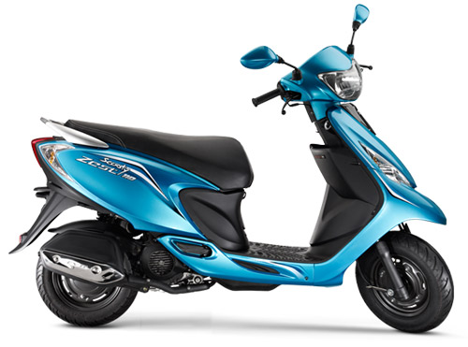
Classification of electric drives
By the sort of mechanical transmission:
geared electric drive in which an electric motor is connected with a working machine by means of one of types of transmission devices
gearless electric drive (direct drive), when an electric motor is connected directly with a machine tool
Motor
Gear box

Slide 15
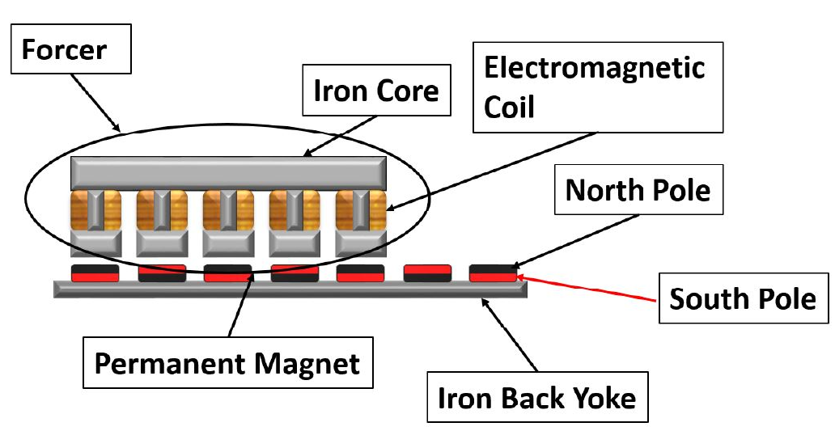
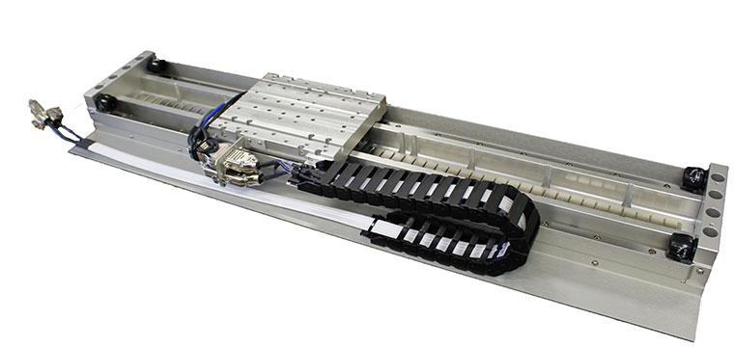
Classification of electric drives
By the type of motion:
unidirectional and reversing rotating
unidirectional and reversing linear motion
Linear motion
Forcer
Permanent Magnet

Slide 16
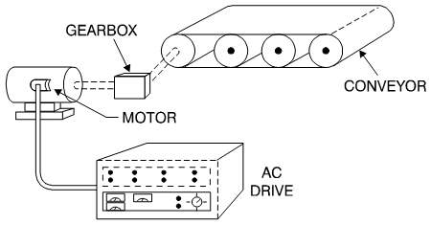
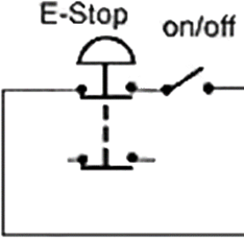
Classification of electric drives
By the level of automation:
uncontrolled electric drive
automated electric drive in which a part of control operations is executed without operator participation;
automatic electric drive, in which full control operations are executed without operator participation.
a)
b)
c)
transducers
transducers

Slide 17
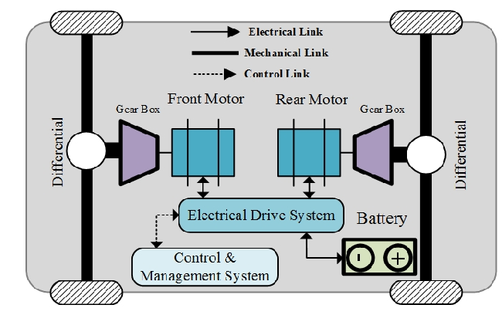
Classification of electric drives
By the type of control system:
open-loop control. It is an electric drive control system in which a feed-back of output coordinate absents;
closed-loop control. It is an electric drive control system in which a feed-back of output coordinate presents;
electric shaft − it is an interconnected electric drive which provides synchronous motion two or more machine tools, not having a mechanical connection.
a)
b)
c)
transducers

Slide 18
Classification of electric drives
By principles of output coordinates control:
controllable electric drive which provides a guided change of machine tool motion coordinates in accordance with requirements of a technological process;
positional electric drive which provides a machine tool transferring to a set position;
follow-up electric drive which provides a machine tool moving in accordance with an arbitrarily changing reference signal;
software programmable electric drive which provides a machine tool moving in accordance with a set program;
adaptive electric drive which automatically adapts to parameters changing and disturbance influences, by a structure and parameters changing of a control system.
ω_{r}
a)
ED
MT
ω
ϕ_{r}
b)
ED
MT
ϕ
ϕ_{r}(t)
c)
ED
MT
ϕ(t)
ω_{r},ϕ_{r}
d)
ED
MT
ω,ϕ
ω_{r}
T_{L}(t)
e)
ED
MT
ω(t)

Slide 19
Classification of electric drives
ω_{r}
By a method of passing to mechanical energy:
individual electric drive − only one machine tool is operated by one engine;
group electric drive − a few machine tools are operated by one engine;
multimotor electric drive − one machine tool is operated by a few electric motors;
interconnected electric drive − an electric drive contains two or a few electric or mechanically connected electric drives, during working of which a set correlation of their speeds, loadings or positions of machine tools is supported.
a)
ED
MT
ω
ω_{r}
MT1
b)
ED
MT2
MT3
ED
M1
M2
M3
ω
ω_{r}
c)
MT
ω
ω_{r}
ED1
d)
ED2
MT
ED3
ω

Slide 20
Basic concepts and determinations
Basic directions of electric drive development

Slide 21
Basic directions of electric drive development
Expansion of automated drives, mainly frequency controlled drives of alternating current with a usage of the fully controlled semiconductor devices
Increase of requirements to accuracy indexes of dynamic and static modes of operations
Expansion and complication of electric drives functions
Expansion of functional possibilities of an electric drive in different production operations and technological processes by application of the numerical control systems and microprocessor devices
Standardization of an element base and creation of a complete electric drive for requirements satisfying of a wide class of production mechanisms
Expansion of power ratings to ten of thousands of kilowatts and considerable variety of their design
Creation of powerful gearless drives of ball and autogenous mills, mine winder, basic mechanisms of excavators and other mechanisms
Increase efficiency and power factor of all electric drive types
Usage of grouped electric drive systems with a common supply for flexible control of electric power streams, energy storage, reactive power compensation etc.

