Slide 1
Fundamentals of electric drive
Electrotechnic faculty
Electric drive department
Presentation #2
Alexander Beshta
Alexander Beshta
141
http://do.nmu.org.ua/course/index.php?categoryid=11

Slide 2
Mechanical part of an electric drive
What is torque-speed characteristic?
Torque-speed curves of machine tools and electric drives
Static stability of an electric drive
Fundamental relationships

Slide 3
Mechanical part of an electric drive
What is torque-speed characteristic?

Slide 4
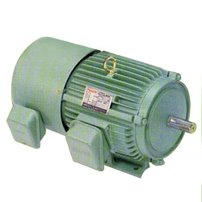
What is torque-speed characteristic?
ω − angular speed, rad/s
Torque-speed characteristic
The sequence of operation points which are defining behaviors of engine (machine-tool)
ω₀ – no load speed
Rated operating point
ω_{r} – rated speed
1
ω₂
2
(starting torque)
− motionless torque,
T_{d}
ω
T_{L}
T_{d,r}=T_{L,1}
_{(rated torque)}
T_{d}=T_{L,2}
T_{d}
− torque, Nm

Slide 5
Mechanical part of an electric drive
Torque-speed curves of machine tools and electric drives

Slide 6
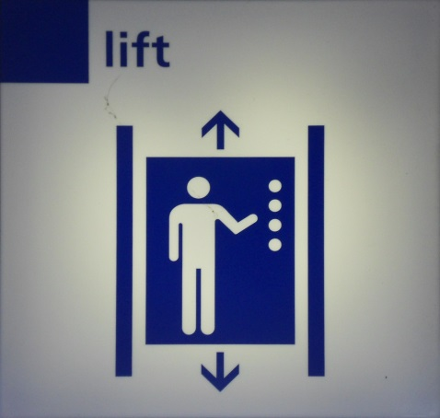
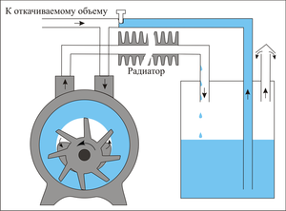
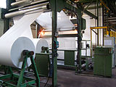
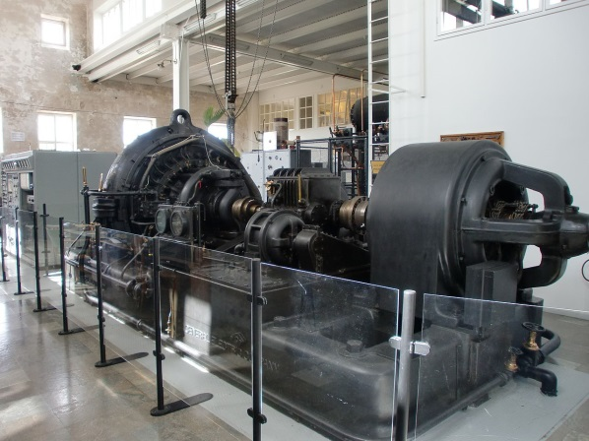
Machine tools: torque-speed characteristics
Elevator, lift, crane
Fan, pump
Coiling machine
Generator
ω_{L}
ω_{L}
ω_{L}
ω_{L}
T_{L}
T_{L}
T_{L}
T_{L}
T₀
T₀

Slide 7
Machine tools: torque-speed curves
ω
1
3
4
− motionless torque,
− rated torque of a machine tool,
2
– rated speed of a machine tool,
− current rate of machine tool speed,
– exponent.
T₀
T_{L}
T₀=T_{L}=T_{r}

Slide 8
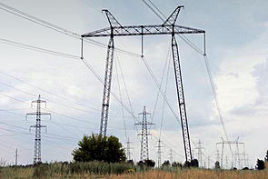
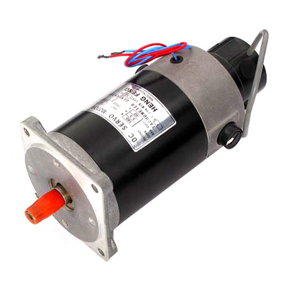
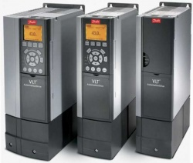
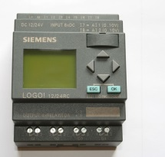
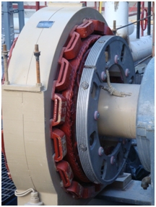
Types of electric motors: torque-speed characteristics
electric drive
ac motor
dc motor
synchronous motor
ω
1
ω
2
ω
ω
T_{d}
T_{d}
T_{d}
T_{d}

Slide 9
Torque-speed curves of electric drives
ω
2
5
1
3
4
T_{d}

Slide 10
DC motor: specific points of torque-speed curves
ω
No load speed
Drop of the speed
ω₀
1
Δω_{L}
ω_{L,1}
1-st curve
Load speed 1
Load torque
Operating point 1
2
ω_{L,2}
Starting point
2-nd curve
Load speed 2
Operating point 2
T_{d}
0
T_{L}
T_{st}

Slide 11
AC motor: specific points of torque-speed curves
ω
Operating point 1
No load speed 1
ω_{0,1}
Drop of the speed
Load speed 1
1
ω_{L,1}
Δω_{L}
Operating point 2
No load speed 2
ω_{0,2}
2
1-st curve
ω_{L,2}
2-nd curve
Load speed 2
ω_{cr,1}
Critical speed 1
Starting torque 1
ω_{cr,2}
Critical torque
Critical speed 2
Starting torque 2
T_{d}
0
T_{L}
T_{st,1}
T_{st,2}
T_{cr}

Slide 12
Synchronous motor: specific points of torque-speed curves
ω
No load speed
1
1-st curve
ω₀=ω_{L}
Δω_{L}=0
Load speed
Operating point 1
Load torque
2
2-nd curve
Operating point 2
T_{d}
0
T_{L}

Slide 13
Mechanical part of an electric drive
Static stability
of an electric drive

Slide 14
Static stability of an electric drive
ω
stiffness
Δω<0
1
(β₁<0)
ω_{L}
ΔT>0
ΔT>0
Δω>0
2
(β₂>0)
T_{d}
T_{L}

Slide 15
Operated part of torque-speed characteristics of the
electric drive
ω
2
Operating part of torque-speed characteristics
$$<0$$
1
3
Overload capacity
$$=\frac{T_{d,max}}{T_{d,rat}}$$
4
T_{d}
T_{d,max}

Slide 16
Mechanical part of an electric drive
Accelerating and decelerating of electric drives

Slide 17
Fundamental relationships
ω
T_{d}
T_{L}
J_{M}
J_{L}
ω
$$J_{tot}=J_{M}+J_{L}$$
T_{L,r}
T_{L,a}
T_{L}

Slide 18
Accelerating of the DC electric drive: $T_{L}=const$
ω
ω₀
2
Positive dynamic
torque
ω_{L,2}
1
ω_{L,1}
T_{d}
T_{L,2}
T_{L,1}
T_{d,st}

Slide 19
Decelerating of the DC electric drive: $T_{L}=const$
ω
ω₀
Negative dynamic
torque
1
ω_{L,1}
2
ω_{L,2}
T_{d}
T_{L,1}
T_{L,2}
T_{d,st}

Slide 20
Accelerating of the DC electric drive: $T_{L}=var$
ω
ω₀
2
Positive dynamic
torque
ω_{L,2}
1
ω_{L,1}
T_{d}
T_{L,st1}
T_{L,2}
T_{L,1}
T_{d,st}
T_{L,st2}

Slide 21
Decelerating of the DC electric drive: $T_{L}=var$
ω
ω₀
1
Negative dynamic
torque
ω_{L,1}
2
ω_{L,2}
T_{d}
T_{L,st1}
T_{L,1}
T_{L,2}
T_{d,st}
T_{L,st2}

Slide 22
Decelerating of the AC electric drive: $T_{L}=const$
ω
Negative dynamic
torque
ω₀
1
ω_{L,1}
2
ω_{L,2}
T_{d,st}
T_{d}
T_{L,1}
T_{L,2}

Slide 23
Accelerating of the AC electric drive: $T_{L}=const$
ω
ω₀
Positive dynamic
torque
ω_{L}
Negative dynamic
torque
T_{d}
T_{L,2}
T_{d,st}
T_{L,1}

Slide 24
Accelerating of the AC electric drive: $T_{L}=var$
ω
ω₀
2
ω_{L,2}
1
ω_{L,1}
Positive dynamic
torque
T_{d}
T_{L,2}
T_{L,1}

Slide 25
Accelerating of the AC electric drive: $T_{L}=var$
ω
Negative dynamic
torque
ω₀
1
ω_{L,1}
2
ω_{L,2}
Attention!
T_{L,2}>T_{d,st}
T_{d,st}
T_{d}
T_{L,1}
T_{L,2}

