Slide 1

Fundamentals of electric drive
Electrotechnic faculty
Electric drive department
Presentation #5
Alexander Beshta
Alexander Beshta
141
http://do.nmu.org.ua/course/index.php?categoryid=11

Slide 2
Load diagram of electric drive
Accelerating and decelerating of the electric drive with constant dynamic torque
Load diagram for active load
Load diagram for reactive load

Slide 3
Load diagram of electric drive
Accelerating and decelerating of the electric drive with constant dynamic torque

Slide 4
Accelerating with constant dynamic torque
ω
Dynamic accelerating torque
T, ω
T_{d} =T₁
ω₀
T_{dyn,a}
ω_{L}
T_{dyn,a}
ω_{L}
T_{dyn,b}
T_{L}
T, ω
T_{d} =T_{L}+ T_{dyn,a}
T₂
t
ω_{L}
T_{dyn,a}
T_{L}
t
T
0
T_{L}
T_{d}=T₁

Slide 5
Operating with constant load torque
ω
T, ω
T_{d} =T₁
ω₀
ω_{L}
T_{dyn,a}
ω_{L}
T_{dyn,b}
T_{L}
T, ω
T₂
t
ω_{L}
T_{dyn,a}
T_{L}
t
T_{d}
0
T_{L}

Slide 6
Decelerating with constant dynamic torque
ω
ω
Dynamic decelerating torque
ω₀
T, ω
T_{d} =T₁
ω₀
T_{dyn,b}
ω_{L}
ω_{L}
T_{dyn,a}
T_{dyn,b}
T_{L}
T, ω
T₂
t
ω_{L}
T_{dyn,a}
T_{dyn,b}
T_{L}
T_{d} =T_{L}-T_{dyn,b}
t
0
T₂
T_{L}
T_{d}
0

Slide 7
Load diagram of electric drive
Load diagram for active load

Slide 8
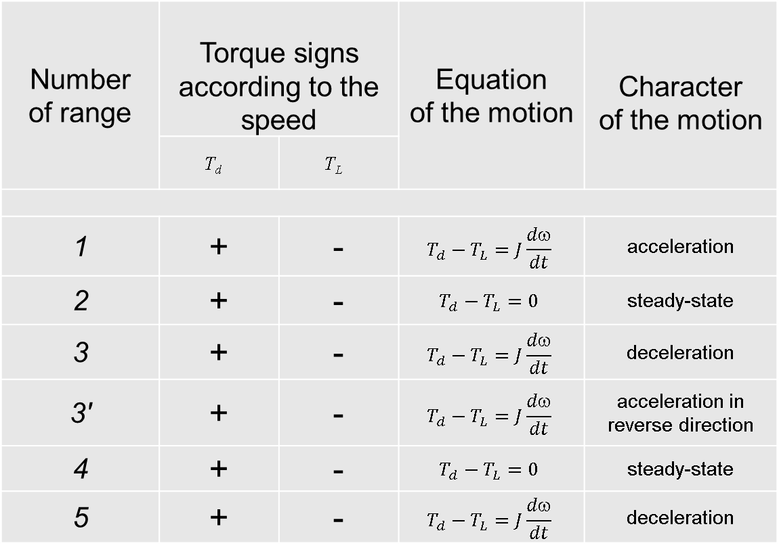
Load diagram for active load
Number of range | Torque signs according to the speed |  | Equation of the motion | Character of the motion
 | T_{d} | T_{L}
1 | + | - | $$T_{d}−T_{L}=J\frac{dω}{dt}$$ | acceleration
2 | + | - | $$T_{d}−T_{L}=0$$ | steady-state
3 | + | - | $$T_{d}−T_{L}=J\frac{dω}{dt}$$ | deceleration
3' | + | - | $$T_{d}−T_{L}=J\frac{dω}{dt}$$ | acceleration in reverse direction
4 | + | - | $$T_{d}−T_{L}=0$$ | steady-state
5 | + | - | $$T_{d}−T_{L}=J\frac{dω}{dt}$$ | deceleration
T, ω
1
2
3
3'
4
5
T_{dyn,a}
2
T_{dyn,b}
T_{L}
1
3
T_{dyn}
t
3’
5
4

Slide 9
Load diagram of electric drive
Load diagram for reactive load

Slide 10

Load diagram for reactive load
T, ω
1
2
3
3'
4
5
Number of range | Torque signs according to the speed |  | Equation of the motion | Character of the motion
 | T_{d} | T_{L}
1 | + | - | $$T_{d}−T_{L}=J\frac{dω}{dt}$$ | acceleration
2 | + | - | $$T_{d}−T_{L}=0$$ | steady-state
3 | + | - | $$T_{d}−T_{L}=J\frac{dω}{dt}$$ | deceleration
3' | + | - | $$T_{d}−T_{L}=J\frac{dω}{dt}$$ | acceleration in reverse direction
4 | + | - | $$T_{d}−T_{L}=0$$ | steady-state
5 | + | - | $$T_{d}−T_{L}=J\frac{dω}{dt}$$ | deceleration
T_{dyn,a}
2
T_{L}
1
3
T_{dyn,b}
t
3’
5
T_{dyn,b}
T_{L}
4
T_{dyn,a}

Slide 11
Load diagram of electric drive
The task
Conveyor is started with a load T_{L} by acceleration a. After that it is moving with the load and constant speed to the next point. After some time it is stopped with deceleration b>a and then unloaded.
The regenerating braking mode is used.
It need to:
build a drawing of the speed and load;
build a trace of operating point motion in the space of the torque-speed characteristics;
torque-speed curves for braking mode.

Slide 12
The solving of the task
ω
ω₀
3
ω_{L1}
2
T, ω
(0)1
2
3
0
T_{dyn,b}
T_{dyn,a}
ω_{L1}
T_{L1}
T_{dyn,b}>T_{dyn,a}
T_{L1}
T_{d}
t
0
T_{dyn,a}
1

Slide 13
Tasks
# var | T_{L} | T_{dyn,a}/T_{L} | T_{dyn,b}/T_{L} | τ_{pause}
1 | reactive | 1 | 1 | =0
2 | reactive | 1 | 1 | ≠0
3 | reactive | 1 | 1/2 | =0
4 | reactive | 1 | 1/2 | ≠0
5 | reactive | 1/2 | 1 | =0
6 | reactive | 1/2 | 1 | ≠0
7 | reactive | 1/2 | 1/2 | =0
8 | reactive | 1/2 | 1/2 | ≠0
# var | T_{L} | T_{dyn,a}/T_{L} | T_{dyn,b}/T_{L} | τ_{pause}
9 | active | 1 | 1 | =0
10 | active | 1 | 1 | ≠0
11 | active | 1 | 1/2 | =0
12 | active | 1 | 1/2 | ≠0
13 | active | 1/2 | 1 | =0
14 | active | 1/2 | 1 | ≠0
15 | active | 1/2 | 1/2 | =0
16 | active | 1/2 | 1/2 | ≠0
ω
τ_{pause}
t

