Slide 1
Fundamentals of electric drive
Electrotechnic faculty
Electric drive department
Presentation #7
Alexander Beshta
Alexander Beshta
141
http://do.nmu.org.ua/course/index.php?categoryid=11

Slide 2
Types of electric drive systems
Types of DC electric drive systems
Types of AC electric drive systems

Slide 3
Types of electric drive systems
Types of DC electric drive systems

Slide 4
Types of DC current drives: G-M system
~
Power
output
I_{a}
+
+
Power
input
G
M
MT
DM
Driving machine
losses
–
Generator
losses
–
Motor
losses
Control input
GFR
MFR
Control input
~
~

Slide 5
Types of DC current drives: TC-M system
e_{A}
e_{B}
e_{C}
e_{A}
e_{B}
e_{C}
e_{p}
Тr
C
Power
input
e_{B}
B
~
α
e_{A}
A
γ
VS1
VS3
VS5
VS1
ТС
ωt
VS1
VS4
VS6
VS2
VS4
VS6
VS2
Control input
VS3
VS6
VS5
VS2
L
М
Motor
losses
+
–

Slide 6
Types of DC current drives: chopping system
S
I_{d}
I_{a}
Rec
V_{d}
D
C_{f}
М
~
DR=$\frac{t_{on}}{t_{c}}$
I_{D}

Slide 7
Types of electric drive systems
Types of AC electric drive systems

Slide 8
Voltage adjuster-induction motor" system (a), dynamic breaking implementation (b) and and torque-speed characteristics (c)
A
B
C
a)
VA
VS1
VS3
VS5
VS7
VS9
Phase
control
system
Speed
controller
V_{ref}
c)
VS2
VS4
VS6
VS8
VS10
(-)
ω
V_{s}> V_{s,1} > V_{s,2} > V_{s,3}
ω₀
ω_{cr}
V_{s}
M
tacho-meter
V_{s,3}
V_{s,2}
V_{s,1}
A
B
C
b)
VS3
VS8
VS9
VS6
T_{st,3}
…
T_{st}
T_{cr,3}
T_{cr,2}
T_{cr,1}
T_{cr}
T_{d}

Slide 9
Slip energy recovery circuit
A
V₁
B
C
P₁
L_{d}
P_{rec}
D1
D3
D5
1
3
VS1
VS3
VS5
+
−
I_{d}
a
IM
e_{r}
b
V_{d2}
V_{d1}
c
P_{s}
−
+
D4
D6
D2
2
4
VS4
VS6
VS2

Slide 10
Scalar control of AC motor
~
$$\frac{v}{f}=const$$
$$v_{rf}$$
$$f_{1,rf}$$
ω
RG
CF
INVERTER
ω_{0,1}
f₃< f₂ < f₁ =50 Gz
f₁
$$E_{rf}$$
$$E$$
ω_{cr,1}
FC
$$−$$
CE
ω_{0,2}
f₂
ω_{cr,2}
BC
$$V_{1A}$$
ω_{0,3}
f₃
$$V_{1B}$$
ω_{cr,3}
$$V_{1C}$$
$$\frac{v}{f^{2}}=const$$
ω
$$E$$
$$_{0,r}$$
$$I_{1A}$$
T_{st,1}
T_{st,2}
T_{st,3}
T_{cr,1}
T_{d}
$$_{0,1}$$
$$I_{1B}$$
ω
$$_{0,2}$$
$$_{0,r}$$
$$\frac{v}{\sqrt{f}}=const$$
$$I_{1C}$$
$$_{0,1}$$
$$_{0,2}$$
$$T_{d}$$
$$T_{cr}$$
$$T_{cr}$$
$$T_{d}$$

Slide 11
3-phases current system
L₁
A₁
C₂
B_{C}
B₂
B_{A}
B₁
B_{B}
C₁
L₃
L₂
A₂

Slide 12
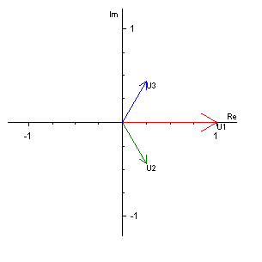
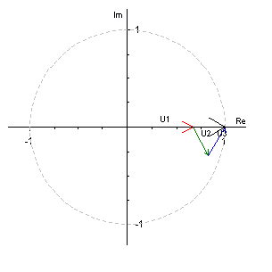
Rotating field
A₁
A₁
B₂
C₂
B₂
C₂
C₁
B₁
C₁
B₁
A₁
A₁

Slide 13
Vector control of AC motor
~
Ψ_{2,rf}
ΔΨ₂
I_{1u,rf}
ΔI_{1u}
V_{1u,rf}
V_{1α,rf}
V_{1A,rf}
FC
CC1
BC
CT2
PC2
INVERTER
-
-
V_{1B,rf}
ω_{rf}
Δω
T_{rf}
I_{1v,rf}
ΔI_{1v}
V_{1v,rf}
V_{1β,rf}
V_{1C,rf}
RG
SC
CC2
-
-
I_{1u}
I_{1α}
I_{1A}
CT1
PC1
I_{1B}
I_{1v}
I_{1β}
I_{1C}
cosθ
sinθ
Ψ_{2α}
Ψ_{0α}
VF
FT
Ψ₂=Ψ_{2m}
Ψ_{2β}
Ψ_{0β}
ω
SS

Slide 14
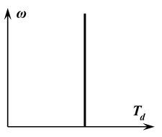
Questions for exam
What is the converter for?
What is the electric motor for?
What is controller for?
What is controller for?
What is the gearbox for?
What is closed loop control system of electric drive?
What kind of output parameters of electric drive is possible to control?
How many electric drives can operate on one machine tool?
How many machine tools can be driven by one electric drive?
What is the torque-speed characteristic?
What is the starting torque?
What is the no-load speed?
What is the rated behavior?
What is the artificial characteristic?
What is the developed torque?
What is the load torque?
Which device has this characteristic? (elevator, lift, crane, fan, pump, coiling machine, generator)?
What is the degree in the load formula for the elevator (elevator, lift, crane, fan, pump, coiling machine, generator)?
What is the torque-speed characteristic of different types of motors?
What kind of electric drive can create the constant torque characteristic?
What is the critical torque of AC motor?
What are the conditions of static stability of AC electric drive?
How can a dynamic torque be created?

Slide 15
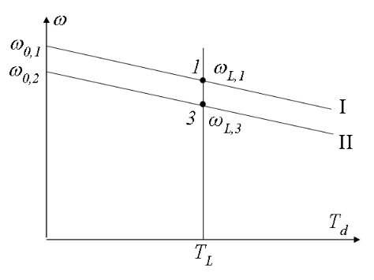
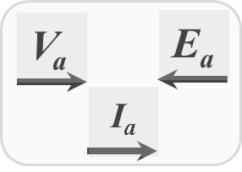
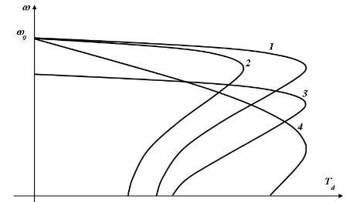
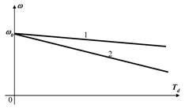
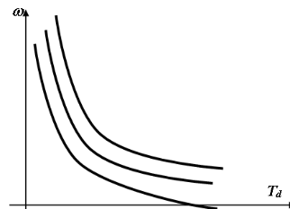
Questions for exam
What is dependence between the sign of the motor speed and sign of the reactive load torque?
What is dependence between the sign of the motor speed and sign of the active load torque?
What ratio between motor torque and load torque need be for acceleration, deceleration of electric drive?
What is happening with motor (not synchronous) speed when the load becomes bigger?
What types of speed control of DC electric drive do you know?
What change in the mode parameter of DC separately excited motor corresponds to the characteristic (example)?
What change in the mode parameter of series DC motor corresponds to the characteristic (example)?
31. What is the trace of electric drive moving from the point 1 to point 3?
What is the trace of electric drive moving from the point 3 to point 1?
Condition of which mode of DC motor is shown on the picture (traction, dynamic, regenerating, counter current braking modes)?
What braking mode of DC motor is the most effective from the point of view saving electric energy?
What types of speed control of AC motor with cage rotor do you know?
What types of speed control of AC motor with 3-phase wound rotor do you know?
What type of regime parameter changing of AC electric motor is represented by each characteristic?

Slide 16
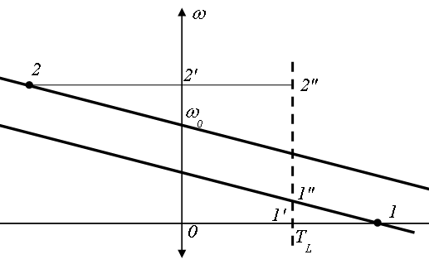
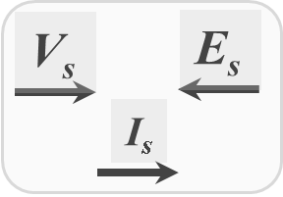
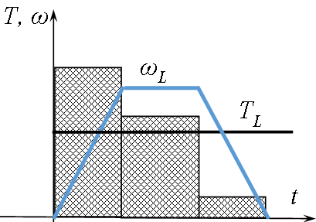
Questions for exam
What devices G-M electric drive system composed of?
What happens when the EMF of the generator of G-M system decreases?
What devices the 'Thyristor converter - motor' system composed of?
What happens when the control angle of the thyristor rectifier increases?
What devices the 'Chopper - DC motor' system composed of?
What happens when the duty ratio DR decreases?
What devices 'Voltage adjuster-induction motor' electric drive system composed of?
What happens when the Voltage adjuster output voltage for AC motor decreases?
What happens when the output frequency of the electric drive system 'Invertor-AC motor' decreases but ratio V/f=const?
What line segment is a dynamic torque in the given point?
What line segment is a developed torque in the given point?
How the equivalent torque diagram of the electric motor is calculated?
What types of speed control of synchronous motor do you know?
Condition of which mode of AC motor is shown on the picture (traction, dynamic, regenerating, counter current braking modes)?
What is the right torque diagram of the electric motor?
How the equivalent torque diagram of the electric motor is calculated?

